Slide 1
Robotics
By Sandhya

Slide 2
What is Electronics?
The term electronics is derived from the word “electrons”. Electronics is a branch of Physics that deals with the theory and use of devices in which the electrons travel through a vacuum, gas, or a semiconductor medium. The motion of electrons takes place under the influence of applied electric and/or magnetic fields.

Slide 3
Branches of Electronics
Digital electronics: Examples-computers, information appliances, digital cameras, digital televisions, flash memory, key USB memory, mobile phones, hard disks, and devices of computer memory.
Analogue electronics: Examples- televisions and computers
Microelectronics: Examples- transistors, capacitors, inductors, resistors, diodes and (naturally) insulators and conductors

Slide 4
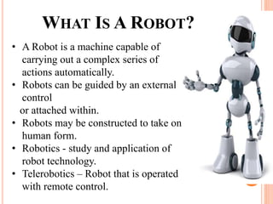

Slide 5
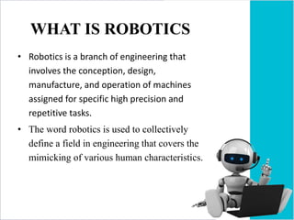

Slide 6
Different Parts of Robotics
Operator Interface
Mobility or Locomotion
Manipulators & Effectors
Programming
Sensing & Perception

Slide 7
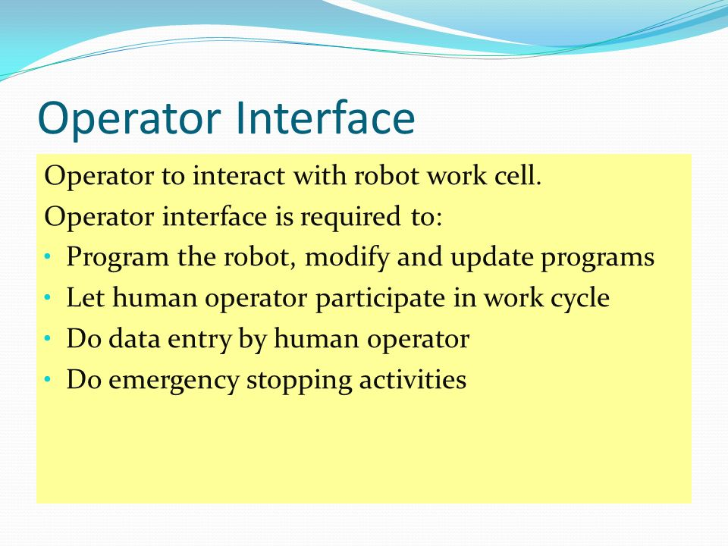

Slide 8
Mobility and Locomotion
Mobility Systems are robots aimed at transporting over variable distance payload. In the context of planetary applications the following classes of Mobility Systems can be used:
Rovers
Hoppers
Aerobots

Slide 9
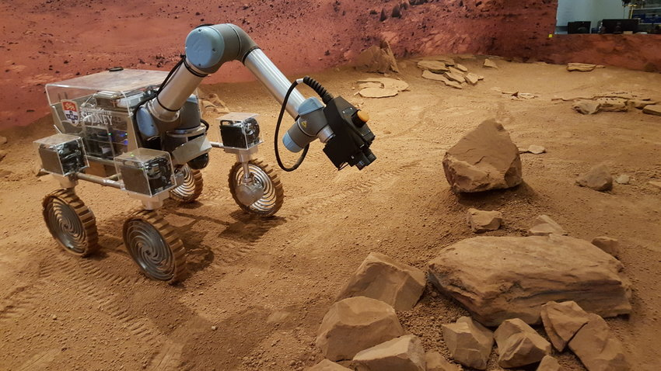
Rovers
Robots moving on the surface of the planet: whether relying on wheels, tracks, legs or other exotic locomotion principles (e.g. shape-change, slithering) these rely on firm contact to the surface to propel themselves.

Slide 10
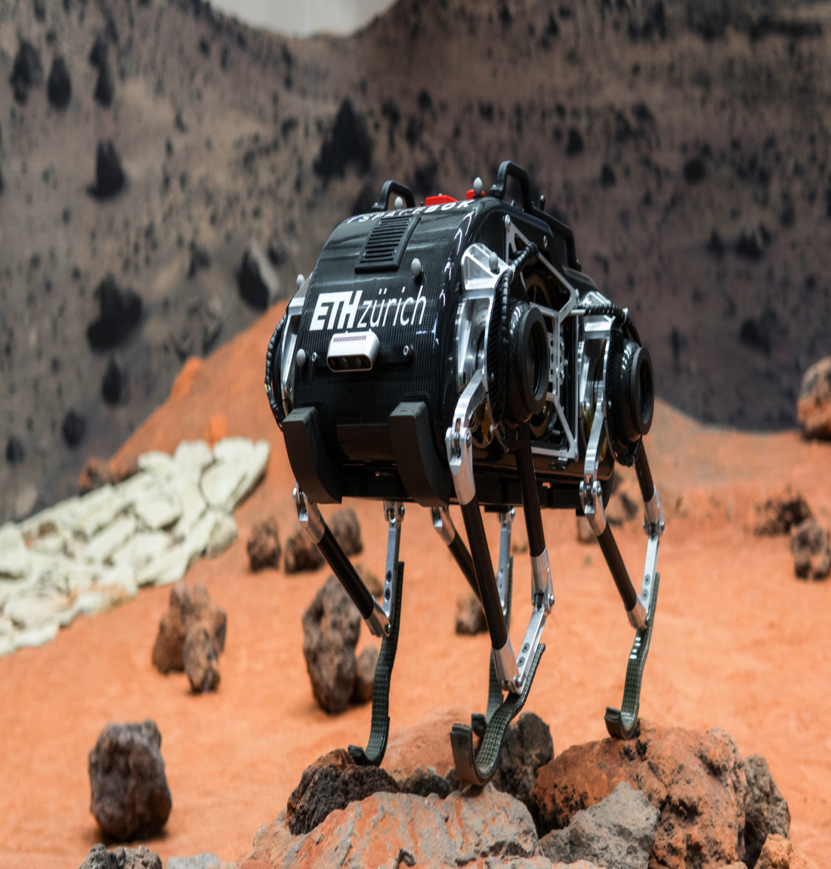
Hoppers
These robots use the principle of hopping to move around. Hopping is particularly attractive in the low gravity conditions such as those experienced in small planets, moons, comets and asteroids. In these conditions with little energy a small hopper can travel long traverses and avoid obstacles many times larger than itself.

Slide 11
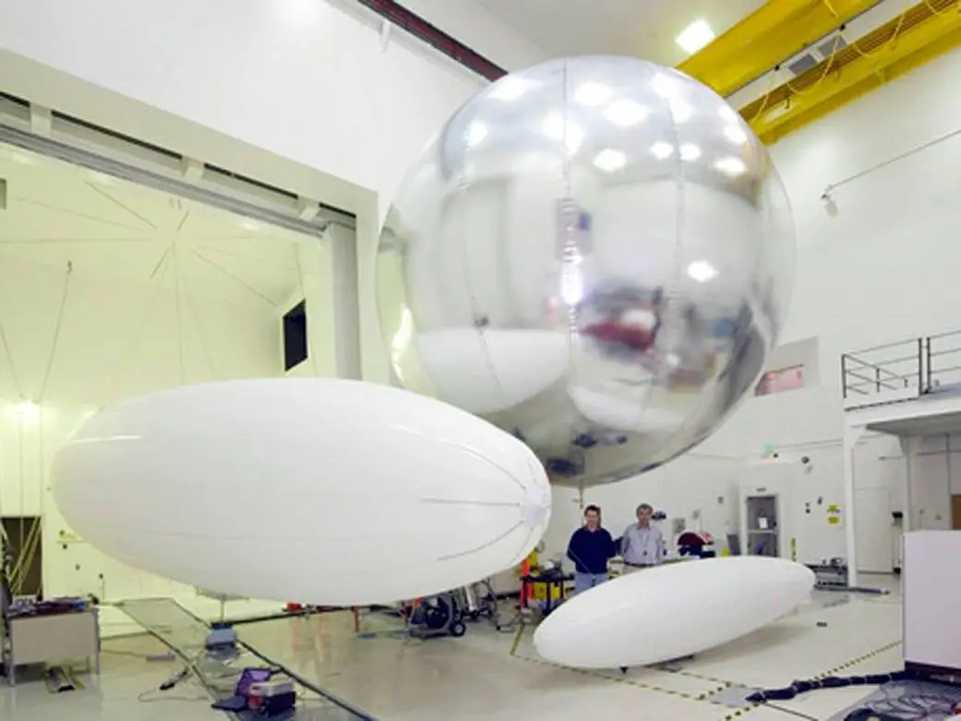
Aerobots
Are robots that move over the surface: in planets endowed with an atmosphere, the static (buoyancy) or dynamic lift generated by the atmosphere makes flying a convenient locomotion means.

Slide 12
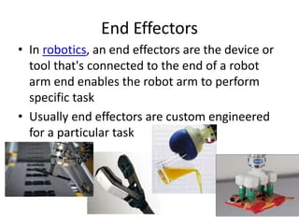
Manipulators & Effectors

Slide 13
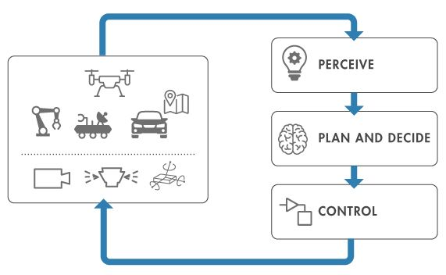
Programming
Robot programming involves writing computer programs that enable a robot to perceive its environment, make plans and decisions, and execute tasks.

Slide 14
Sensing & Perception
Sensation and perception are two separate processes that are very closely related. Sensation is input about the physical world obtained by our sensory receptors, and perception is the process by which the brain selects, organizes, and interprets these sensations.

Slide 15
Thank You

